Slide 1
PYTHON PROJECT
Dated: 23rd DECEMBER 2022
Submitted By: GROUP - 29
Student Names: Rajat Sharma, Rajveer Singh, Rohan Lakhanpal
Roll No’s.: 2210990707, 2210990711 and 2210990741
Section: AA(G-27)
Sem: 1

Slide 2
Project Details
Project Name: Multipurpose App
Programming Tool : Python, Tkinter Toolkit for GUI, random module
Team Members Rajat Sharma(2210990707), Rajveer Singh(2210990711) & Rohan Lakhanpal(2210990741)
Task done by each member :
Rajat Sharma ( 2210990707 ): Coded Calculator, worked on GUI of the calculator through tkinter and tested all the modules
Rajveer Singh ( 2210990711 ):
Coded the guessing game, worked on GUI of the game through tkinter. Validated all the working modules.
Rohan Lakhanpal ( 2210990741 ): Coded the password generator, ran all the test cases and maintained the records of the project .
2

Slide 3
Project Introduction
Welcome to our multipurpose Python application! This application consists of three main components: a number guessing game, a calculator and a password generator.
Number Guessing Game : The number guessing game allows you to test your luck and guessing skills by challenging you to guess a random number between 0 and 100 within 10 tries.
Simple Calculator : The calculator allows you to perform basic arithmetic operations and provides the result in real time.
Password Generator : The password generator allows you to generate random passwords of any length with a combination of uppercase letters, lowercase letters, numbers, and special characters and it also let’s the user copy the generated password.
How to use the application: To use the application, simply select the component you want to use by entering the corresponding number at the prompt. You can switch between components at any time by returning to the menu by closing the currently open app and selecting a different component."
3

Slide 4
Technologies used in Project
These are the key technologies used in our Python program:
Python : This is the programming language in which the program is written.
Tkinter : This is a Python library built on top of the Tk GUI toolkit, which is a library for creating graphical user interfaces in Python programming language. It is used to create the GUI elements and manage the program's behavior.
GUI widgets : The program uses various Tkinter widgets, such as labels, buttons, and text fields, to create the interface for the number guessing game, calculator, and password generator. These widgets allow the user to enter numbers, perform arithmetic operations, and specify the desired password length and character options in our code.
Functions and methods : The program uses various inbuilt and user defined functions and methods to handle user input, display output, and manage the game mechanics. For example, the program uses the grid method to layout the GUI elements in a grid, the get method to retrieve the user's input, and the insert method to display text in the text area.
Random module : The program uses the random module to generate a random number for the number guessing game. This module provides functions for generating random numbers and choosing random elements from a list. user.
4

Slide 5
Basic Working of Project
When the program is run, it presents the user with a menu that allows them to select which program they want to run by entering a number at the prompt.
If the user selects the number guessing game (by entering "1" at the prompt), the program opens a Tkinter window with instructions for the game and provides a text entry field and buttons for the user to enter a number between 0 and 100. The program generates a random number between 0 and 100, and the user has 10 chances to guess the number. The program provides feedback to the user about whether their guess is too high or too low, and if the user guesses the correct number within 10 tries, they win the game. If the user runs out of guesses, the game ends then they can either guess a new number in another 10 tries or close the program to exit the game.
If the user selects the calculator (by entering "2" at the prompt), the program opens a Tkinter window with a calculator interface. The user can enter numbers and perform basic arithmetic operations using the buttons provided. The calculator displays the result of the arithmetic operation in a text field.
If the user selects the password generator (by entering "3" at the prompt), the program opens a Tkinter window with a password generator interface. The user can enter the desired length of the password in a text field and generate a random password by pressing a button. The program combines uppercase letters, lowercase letters, numbers, and special characters to generate a strong password. The generated password is displayed in a text box which can be copied by the user or they can generate another password of a different length.
The program runs continuously until the user decides to exit by entering "0" at the prompt.

Slide 6
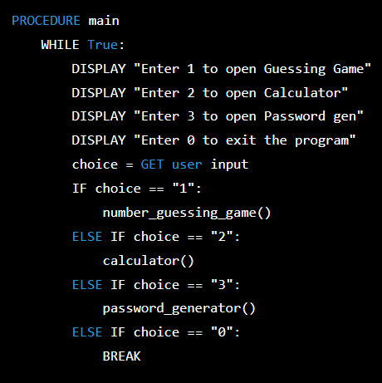
Working of Project
Psuedocode of program and it’s working:
The main procedure is the starting point of the program.
It is a while loop that continues to execute until the user enters "0" to exit the program. The main procedure displays a menu to the user and prompts them to enter a number to select a component.
If the user enters "1", the main procedure calls the game procedure to start the number guessing game.
If the user enters "2", the main procedure calls the calculator procedure to start the calculator.
If the user enters "3", the main procedure calls the password_generator procedure to start the password generator.
If the user enters "0", the main procedure breaks out of the loop and ends the program.

Slide 7
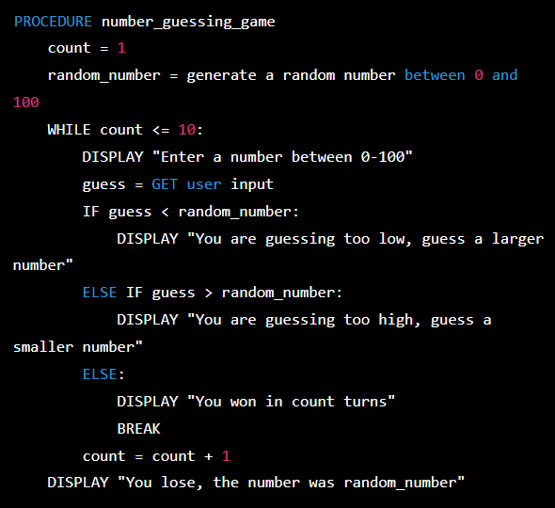
Working of Project (cont.)
Psuedocode of Number Guessing Game:
The number_guessing_game procedure is responsible for implementing the mechanics of the number guessing game.
It begins by generating a random number between 0 and 100, and initializing a counter count to 1. Then, it enters a loop that continues until the user has made 10 tries or guesses the correct number. Inside the loop, the game procedure prompts the user to enter a number between 0 and 100. It then checks if the user's guess is less than the random number, in which case it displays a message telling the user to guess a larger number. If the guess is greater than the random number, the game procedure displays a message telling the user to guess a smaller number. If the guess is correct, the game procedure displays a message indicating that the user won in how many turns, and then breaks out of the loop. If none of these conditions are met, the game procedure increments the counter count and continues the loop. If the loop completes without the user guessing the correct number, the game procedure displays a message indicating that the user lost and the correct number was (random_number).

Slide 8
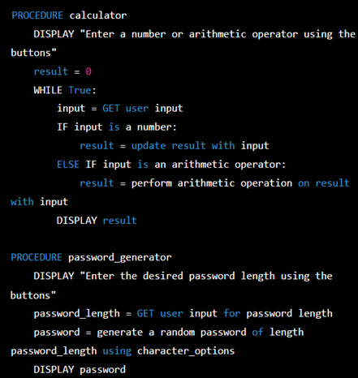
Working of Project (cont.)
Psuedocode of calculator and Password Generator it’s working:
The calculator procedure is responsible for implementing the mechanics of the calculator. It displays a prompt to the user and enters a loop that continues until the program is closed. The calculator procedure gets user input and updates the result with the input if it is a number, or performs an arithmetic operation on the result with the input if it is an arithmetic operator. The calculator procedure displays the result after each operation.
The password_generator procedure is responsible for generating a random password based on the user's specified length and character options. It displays a prompt to the user and gets user input for the desired password length. The password_generator procedure generates a random password of the specified length using the specified character options, and displays the password to the user.

Slide 9
Implementation of Number Guessing Game
The game is implemented using several functions and modules:
random module: This module is used to generate a random number for the user to guess. The randint function is used to generate a random integer between 0 and 100.
Tk module: This module from the tkinter library is used to create the GUI (graphical user interface) for the game. The Tk class is used to create the main window for the game, and various widgets (such as labels, buttons, and text fields) are added to this window to create the game's interface.
game function: This is the main function for the game. It takes in a number n that the user has guessed, and compares it to the randomly generated number. If the user's guess is too high, too low, or correct, the function returns a message indicating the outcome of the guess. The function also keeps track of the number of turns the user has taken and ends the game if the user runs out of turns or guesses the correct number.
number_input function: This function is called when the user clicks one of the buttons representing a number (0-9). It retrieves the current value in the entry field, appends the clicked number to the end of this value, and updates the entry field with the new value.
clear_values function: This function is called when the user clicks the "Clear" button. It clears the contents of the entry field.
entry function: This function is called when the user clicks the "Enter" button. It retrieves the value in the entry field, passes it to the game function, and displays the result in the output field.

Slide 10
Implementation of Number Guessing game (cont.)
GUI Buttons: Several buttons are created using the Button class from the tkinter library. These buttons are used to allow the user to interact with the game and input their guesses.
Here is a list of the buttons and their functions:
Button with text "9", "8", "7", "6", "5", "4", "3", "2", "1", "0": These buttons are used to input numbers into the entry field. When the user clicks on one of these buttons, the corresponding number is appended to the end of the current value in the entry field.
Button with text "Clear": This button is used to clear the contents of the entry field. When the user clicks on this button, the clear_values function is called, which clears the contents of the entry field.
Button with text "Enter": This button is used to submit the user's guess to the game. When the user clicks on this button, the entry function is called, which retrieves the value in the entry field, passes it to the game function, and displays the result in the output field.
Output Field: The output field is created using the ScrolledText class from the tkinter.scrolledtext module. It allows the user to scroll through the output if it is too long to fit in the widget. This field is used to display the results of the user's guesses and the outcome of the game.
Mainloop( ): mainloop method is called on the anmol_root window object, which is the main window of the guessing game. It is used to start the event loop and wait for the user to interact with the program.

Slide 11
Implementation of Calculator
The calculator is implemented using several functions and modules:
Tk module: This module from the tkinter library is used to create the GUI (graphical user interface) for the calculator. The Tk class is used to create the main window for the calculator, and various widgets (such as labels, buttons, and text fields) are added to this window to create the calculator's interface.
Entry function: This function is called when the user clicks the "Enter" button. It retrieves the values in the entry fields for the two numbers and the operator, and gives the answer when equal to is pressed.
number_input function: This function is called when the user clicks one of the buttons representing a number (0-9). It retrieves the current value in the entry field, appends the clicked number to the end of this value, and updates the entry field with the new value.
clear_values function: This function is called when the user clicks the "Clear" button. It clears the contents of the entry field.
operator function: This function is called when the user clicks one of the buttons representing an operator (+, -, *, /). It retrieves the current value in the entry field, appends the clicked operator to the end of this value, and updates the entry field with the new value.
GUI: The GUI (graphical user interface) of the calculator in the given code is created using the Tk class from the tkinter library. The Tk class is used to create the main window for the calculator, and various widgets (such as labels, buttons, and text fields) are added to this window to create the calculator's interface. The list of methods used for GUI of calculator is on the next slide.

Slide 12
Implementation of Calculator (cont.)
Here is a list of the widgets that are used to create the calculator's interface:
Entry: Entry fields are used to allow the user to input values. In this case, there are two entry fields for the two numbers and one entry field for the operator.
Button: Buttons are used to allow the user to interact with the calculator. In this case, there are buttons for the numbers 0-9, the operators +, -, *, /, and the "Enter" and "Clear" buttons.
Grid: The calculator's interface is created using a grid layout, which allows the widgets to be arranged in a grid of rows and columns. This makes it easy to position the widgets on the window and adjust the layout as needed.
Mainloop( ): mainloop method is called on the root window object, which is the main window of the guessing game. It is used to start the event loop and wait for the user to interact with the program.

Slide 13
Implementation of Password Generator
The password generator is implemented using several functions and modules:
Modules:
Tkinter: A Python module for creating GUI applications.
random: A Python module for generating random numbers.
Functions:
Tk(): A Tkinter function for creating a main window.
configure(): A Tkinter function for configuring various properties of a widget, such as its background color.
Label(): A Tkinter function for creating a label widget, which displays text.
Spinbox(): A Tkinter function for creating a spinbox widget, which allows the user to choose a value from a list of options.
Button(): A Tkinter function to create a button widget, it can be clicked by the user to perform an action.
Text(): A Tkinter function for creating a text widget, which displays multiple lines of text.
pack(): A Tkinter function for organizing widgets in a horizontal or vertical layout.
random.sample(): A function from random module to generate random samples from a population.
clipboard_clear(): A function for clearing the clipboard.
clipboard_append(): A Tkinter function for adding text to the clipboard.
mainloop(): A Tkinter function for running the main loop, which keeps the window open until the user closes it.

Slide 14
Implementation of Password Generator(cont.)
GUI interface:
Main window: The main window of the application, created using the Tk() function.
Label: A widget that displays text, created using the Label() function.
Spinbox: A widget that allows the user to choose a value from a list of options, created using the Spinbox() function.
Button: A widget that can be clicked by the user to perform an action, created using the Button() function.
Text widget: A widget that displays multiple lines of text, created using the Text() function.

Slide 15
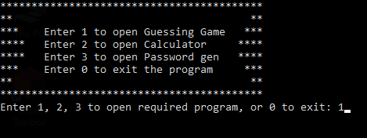
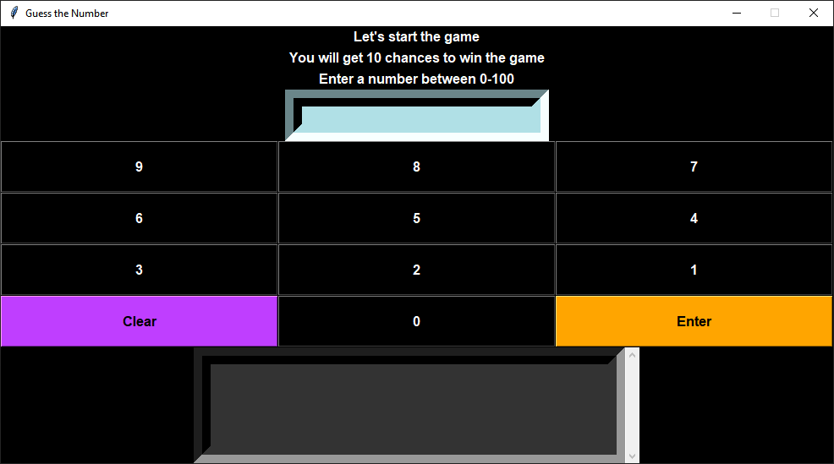
Output snapshots
The output snapshots of our program are as follows:
This is the prompt the users get when they first open the program, entering anything else other than 1,2,3 or 0 would not do anything.
This is the final output of our Guess the number game. Users would have to use the buttons to type their guesses and then press enter.

Slide 16
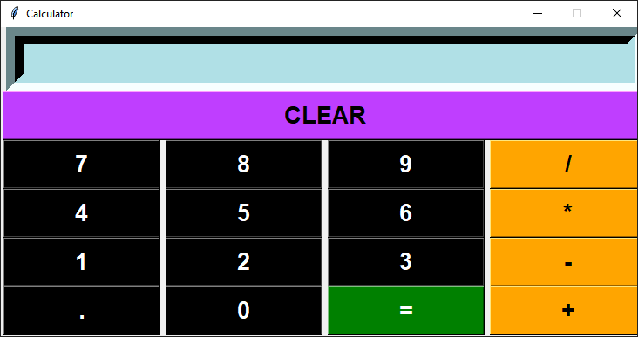
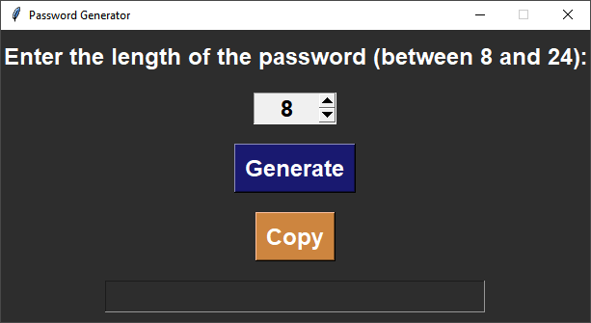
Output snapshots (cont.)
The output snapshots of our program are as follows:
This is the final calculator window which opens when users enters 2 in the prompt. User would have to enter the numbers using the buttons and use operators according to their needs, to get the final answer they need to press the “=” button.
This the Password generator which opens when user enters 3 in the prompt window. Users need to set the length of password required using the arrow buttons next to the length field and then click generate button to get the password in the output field, the user can also copy the password to windows clipboard using the copy button.

Slide 17
Future Scope of Guessing Game
Add additional game modes: The game could be modified to include different modes or difficulty levels. For example, the user could choose to play a mode where they have to guess a number between 0 and 1000, or a mode where they only have 5 chances to guess the correct number.
Incorporate visual elements: The game could be made more visually appealing by adding graphics or animation. For example, the program could display a progress bar to show how many chances the user has remaining, or animate the output messages to make them more attention-grabbing.
Add a leaderboard or high score feature: The program could track the user's performance over multiple games and display a leaderboard or high score list. This could add an element of competition and encourage the user to try to improve their score.
Integrate with other platforms or technologies: The game could be modified to work with other platforms or technologies, such as mobile devices. This could allow the user to play the game in different contexts or environments.
Add additional features or functionality: The game could be modified to include additional features or functionality, such as the ability to customize the range of numbers to guess from or to display hints or clues to help the user guess the correct number.
17

Slide 18
Future Scope of Calculator
Add more advanced features: The calculator could be enhanced to include more advanced features such as scientific functions (e.g., sine, cosine, tangent), complex number support, or matrix operations.
Incorporate visual elements: The calculator could be made more visually appealing by adding graphics or animation. For example, the program could display an animation when the user clicks on a button, or use different colors or font styles to highlight important information.
Integrate with other platforms or technologies: The calculator could be modified to work with other platforms or technologies, such as mobile devices. This could allow the user to use the calculator in different contexts or environments.
Add additional functionality: The calculator could be modified to include additional functionality, such as the ability to save and recall calculations, or to perform conversions between different units of measurement.
Customize the appearance: The calculator could be customized to have a unique look or theme. For example, the program could use a different color scheme or set of buttons to create a specific aesthetic.
18

Slide 19
Future Scope of Password Generator
Add more customization options: The program could be modified to allow the user to choose which types of characters (lowercase letters, uppercase letters, numbers, symbols, etc.) to include in the generated password. This would give the user more control over the complexity and security of their passwords.
Incorporate visual elements: The program could be made more visually appealing by adding graphics or animation. For example, the program could display an animation when the user clicks on a button, or use different colors or font styles to highlight important information.
Integrate with other platforms or technologies: The password generator could be modified to work with other platforms or technologies, such as mobile devices or web browsers. This could allow the user to generate and manage passwords in different contexts or environments.
Add additional security features: The program could be enhanced to include additional security features, such as the ability to check the strength of a generated password or to store passwords securely in a password manager.
Customize the appearance: The password generator could be customized to have a unique look or theme. For example, the program could use a different color scheme or set of buttons to create a specific aesthetic.
19

Slide 20
Conclusion
Guess the Number game:
In conclusion, the guessing game implemented in this code is a simple, fun, and interactive way to engage users. It combines the use of the Tkinter library in Python with basic game design principles to create a user-friendly program that can be enjoyed by people of all ages.
Overall, the guessing game is a great example of how Python and Tkinter can be used to create interactive and entertaining programs. It serves as a useful tool for learning about programming concepts and can provide hours of entertainment for users.
Calculator:
In conclusion, creating a calculator using Python and Tkinter is a simple and effective way to learn about the basics of python and GUI development. By using the Tkinter module and its functions and classes, we created a graphical user interface (GUI) for our calculator that includes buttons, text fields, and other elements of the calculator's interface. We used the eval() function to evaluate the mathematical expressions entered by the user, and add additional features and functionality to your calculator as needed.
Overall, creating a calculator using Python and Tkinter was a fun and educational project that provides a good introduction to the basics of Python and GUI development in Python. With some additional programming and design skills, we created a simple calculator that is easy to use and provides a wide range of functionality.
20

Slide 21
Conclusion (cont.)
Password Generator:
In conclusion, the password generator program implemented in this code is a useful tool for creating secure, random passwords. It combines the use of the Tkinter library in Python with a simple and intuitive user interface to create a program that is easy to use and understand.
Overall, the password generator is a great example of how Python and Tkinter can be used to create functional and user-friendly programs. It serves as a valuable resource for creating secure passwords and can be a useful addition to any toolkit.
21

Slide 22
THANK YOU
22

